Slide 1
Faster R-CNN Restnet50
IMGS – 389
Cazuc Ewen
1

Slide 2
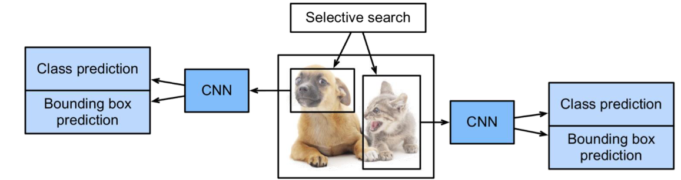
Region based CNN (R-CNN)
Selective search -> generate regions of interest
CNN performed on each region
Class prediction
Bounding Box prediction
2

Slide 3
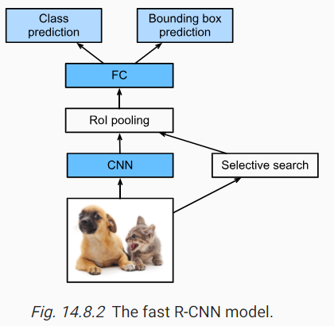
Fast R-CNN
CNN performed on the image -> generate a feature map
Introduction of RoI pooling
3

Slide 4
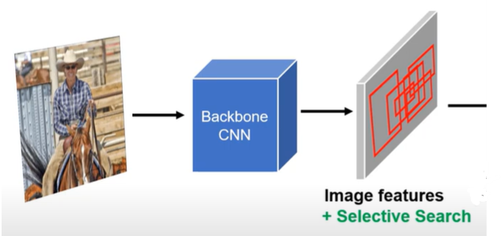
Fast R-CNN
4

Slide 5
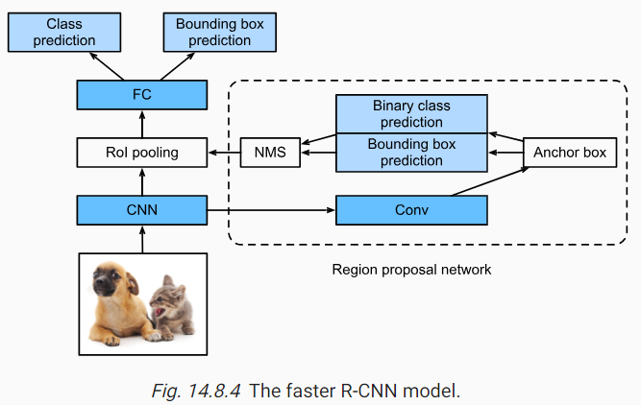
Faster R-CNN
5

Slide 6
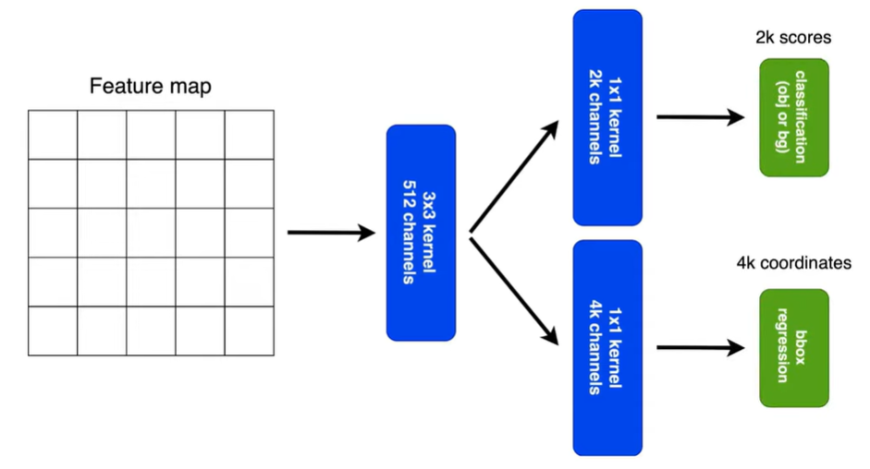
Region proposal network
6

Slide 7
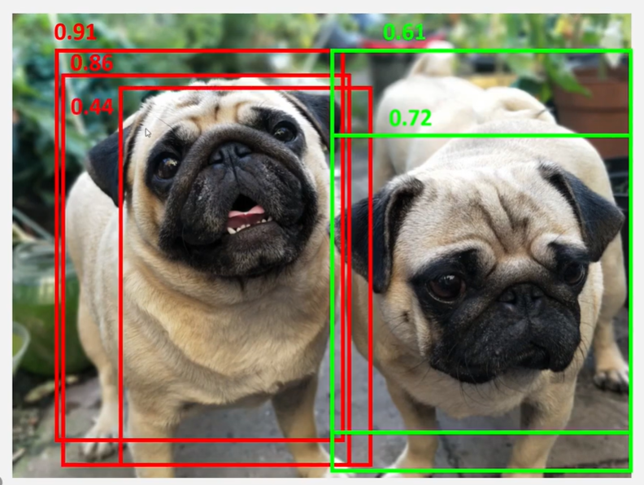
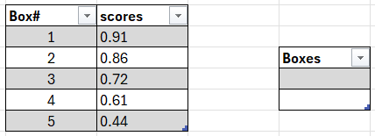
Non Max suppression
7

Slide 8
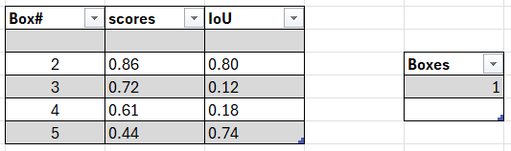
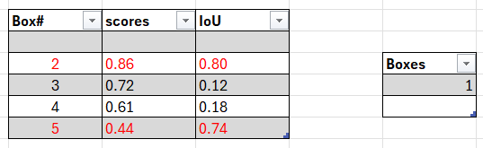
Non Max suppression
Threshold = 0.5
8

Slide 9
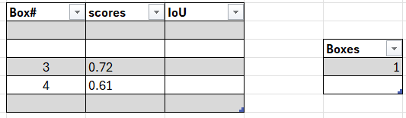
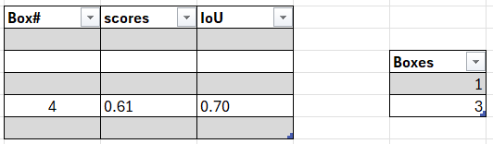
Non Max suppression
Threshold = 0.5
9

Slide 10
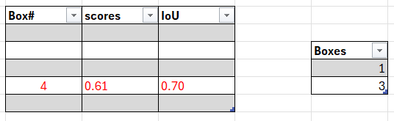
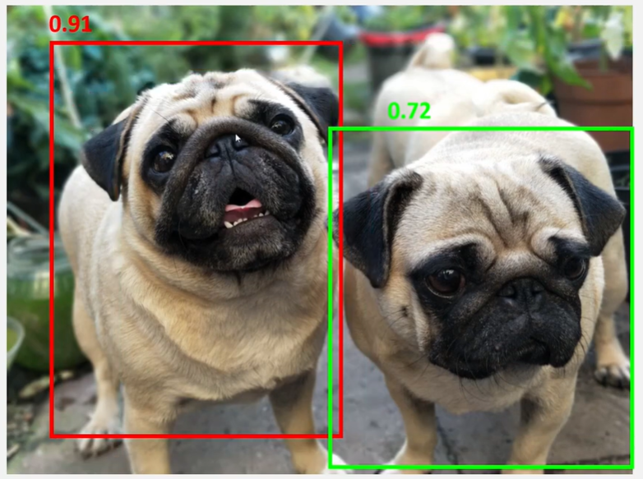
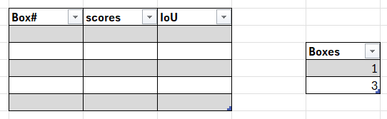
Non Max suppression
10

Slide 11
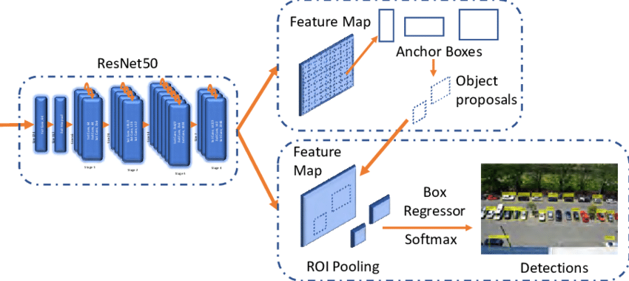
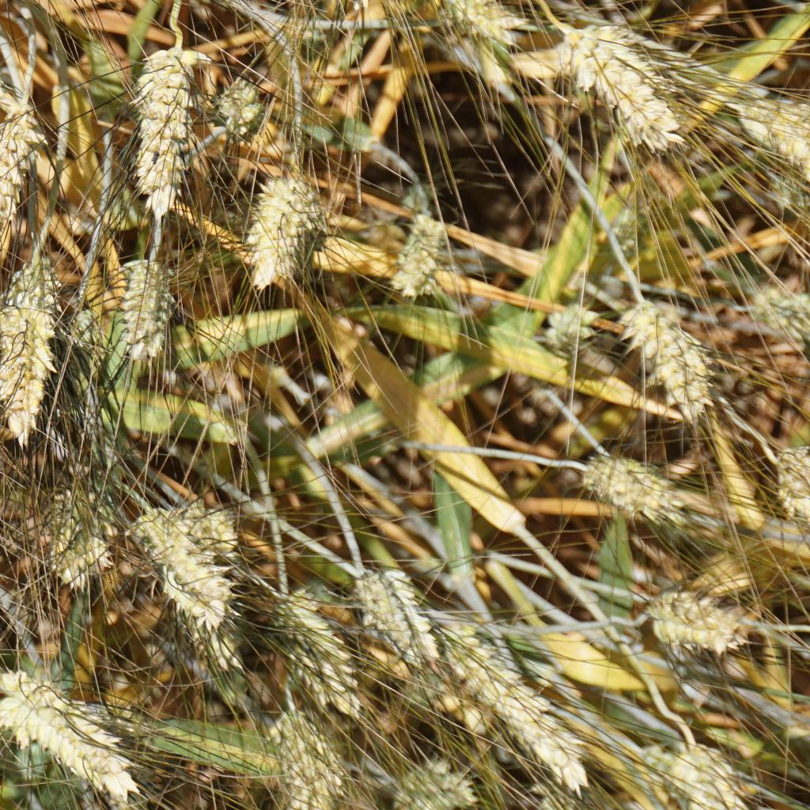
Faster R-CNN Resnet50
Resnet 50 :
50 layers
ReLU activation function
Libraries :
Pandas version: 2.2.1
Numpy version: 1.26.4
Torch version: 2.2.2
Torchvision version: 0.17.2
11

Slide 12
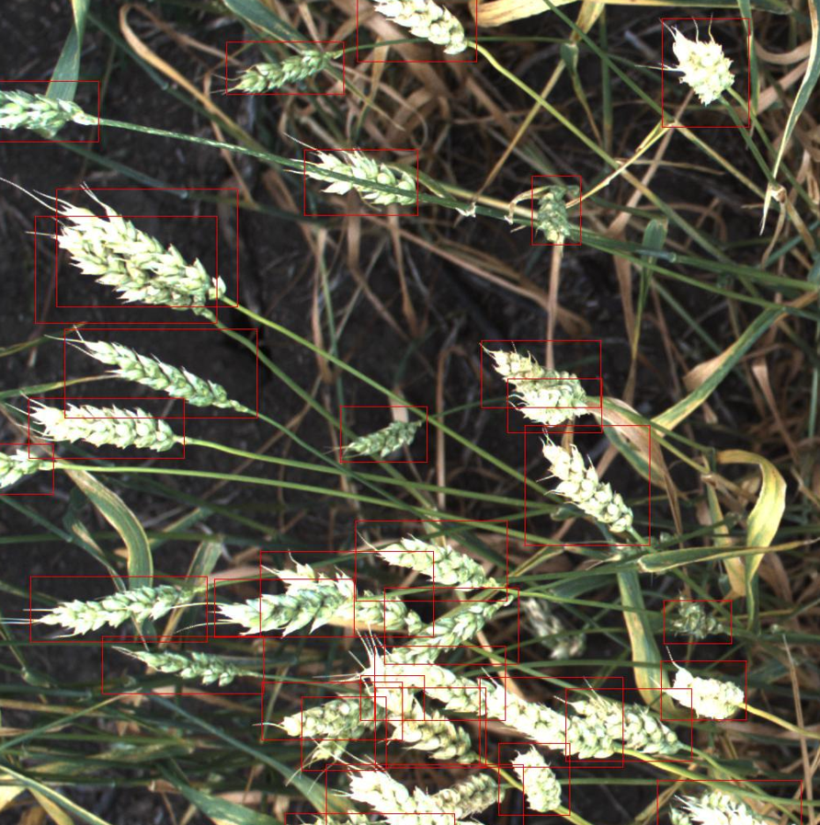
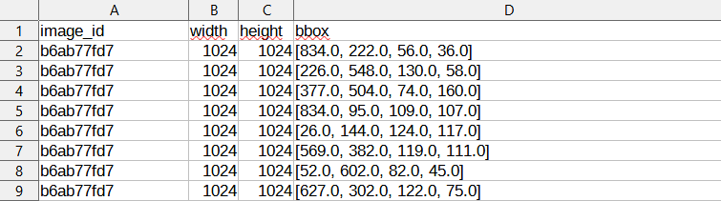
THE Dataset
Wheat head detection dataset :
3422 images
Bonding box data : top left coordinate, height and width
12

Slide 13
THE Dataset
(x1, y1)
w
(x1, y1)
h
(x2, y2)
13

Slide 14
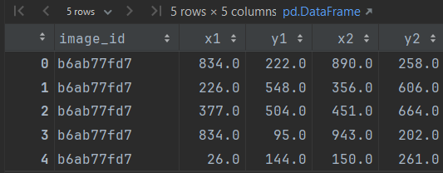
THE Dataset
X2 = X1 + W
Y2 = Y1 + H
14

Slide 15
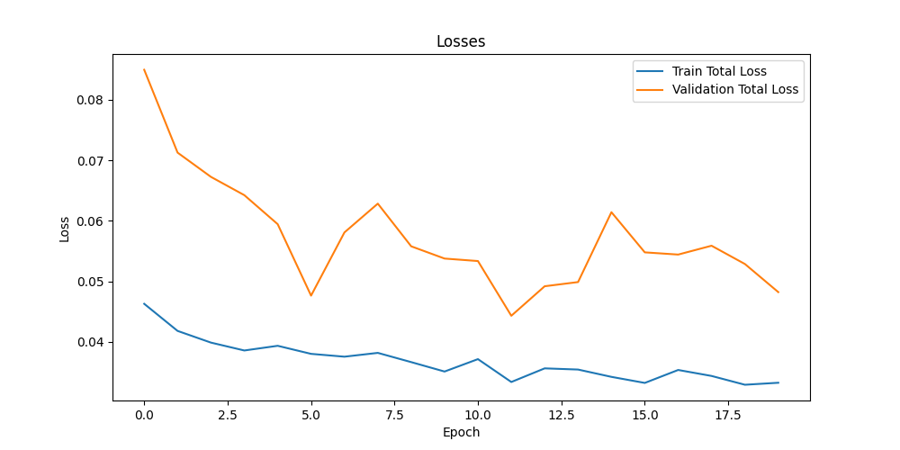
Training the model
Batch Size : 16
Learning Rate : 0.0001
Weight Decay : 0.001
15

Slide 16
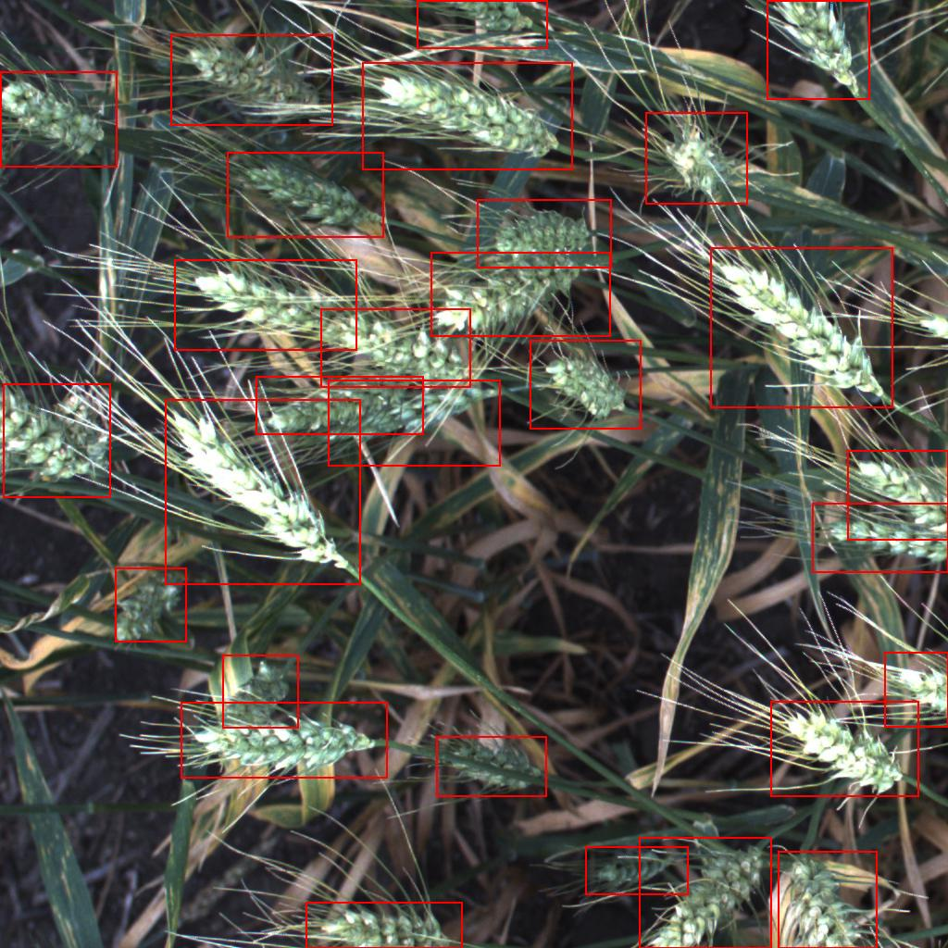
Evaluate the model
Threshold : 0.5
16

Slide 17
Any questions ?
17

